Slide 1

Intro to Coding
Session 2: Potentiometers + Servos

Slide 2
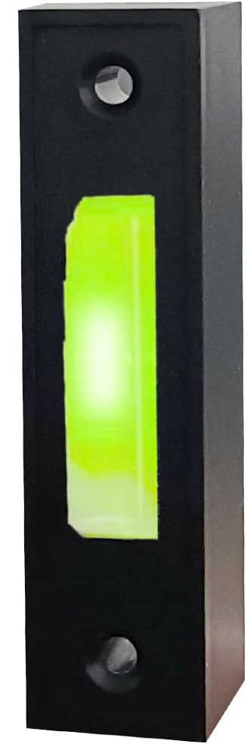
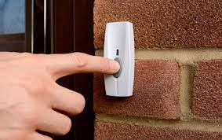
Doorbell

Slide 3
Embedded Systems = Hardware + Software
Hardware: Physical Devices
Shields
Push Buttons
Potentiometers (again)
Buzzers (piezoelectric)
Software: Digital Tools
Define & Variables
Serial Monitor Pt 2
Conditional Statements

Slide 4
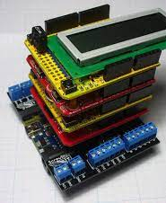
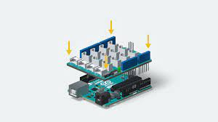
Shields
Attach onto an Arduino
Provide specific functionality

Slide 5

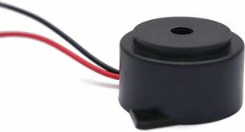
Buzzers
Produce sound
Change Pitch

Slide 6

New Code!

Slide 7

#Define
Similar to variable creation
Cannot change during your code
Saves space/memory on board

Slide 8

Making Sounds
tone(pin, frequency)
tone(pin, frequency, duration)

Slide 9

Serial Print
Serial.print - Prints to Monitor
Serial.println -Prints to Monitor & goes to a new line

Slide 10

Commenting out
Add comments to a line //
Temporarily makes board skip that code

Slide 11

Code Play
Comment out noTone and second delay command
What could I change about the code to make the frequency twice as high?

Slide 12
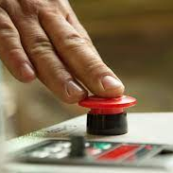
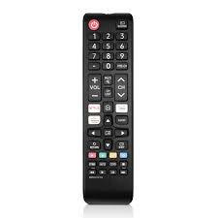
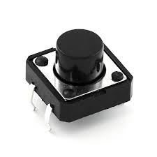

Buttons
Two states (pushed or not pushed)

Slide 13
New Code!

Slide 14

Conditional Programming
Conditions allow board to ‘make choices’
If button pressed
Turn on Light
Else (button is not pressed)
Turn off Light

Slide 15

Multiple Conditions
If button1 and button2 pressed
Get an orange
Else IF button1 pressed
Get an apple
Else IF button2 pressed
Get a grape
Else
No Fruit

Slide 16
Order Matters
If button1 pressed
Get an apple
Else IF button2 pressed
Get a grape
Else IF button1 and button2 pressed
Get an orange
Else
No Fruit

Slide 17
Arduino Example
if (button_state == true) {
digitalWrite(LED, HIGH);
}
else {
digitalWrite(LED, LOW);
}

Slide 18

Challenge - Doorbell
Create a new code that acts as a doorbell
When button is pressed, LED lights up and a sound is created
When button is not pressed, LED is off and sound stops

